Slide 1


Volume 26/ November & December, 2024
POSITIVE LINK
A MONTHLY MODERN HIGHER SECONDARY SCHOOL PUBLICATION
Index
Editorial 1
Activities 2-19
Poetry 20-22
Quote 23
Message 24
Campus Diary 25-26
The Power of Teamwork
Teamwork is one of the most important and inspiring value we share. Throughout our school, teamwork isn’t just a word; it’s a way of life. It’s seen in every classroom, club, sports team, and project, where students come together to achieve common goals, support one another, and make a lasting impact. When we work as a team, we learn valuable lessons that reach beyond academics. We discover how to listen to each other’s ideas, overcome challenges together, and appreciate the unique strengths each person brings to the table. Whether it’s a group project, a school activity, or a big game, it’s clear that our accomplishments are greater when we stand together. You’ll find articles about how teams across our school—from debate teams to sports team to team projects—have accomplished remarkable things. These stories remind us that teamwork builds more than success; it builds trust, friendships, and a sense of belonging. Here’s to the teamwork that makes our school a place of shared growth and endless possibility.
-Rehana Khatun
Class 12 commerce
Information:
For more School
updates
follow us on:
Instagram
@modern_Hr_sec_school_official
www.mhss.edu.in
Email:
admin@mhss.edu.in

Slide 2
ACTIVITIES
Inter-School Dance Competition
Ms. Emei, Ms. Manle & Ms. Amnon Konyak won the 2nd Position in the Inter-School Dance Competition organised by Model Christian College & Model Higher Secondary School on 2nd November, 2024.

Slide 3
ACTIVITIES
Awareness and Education Programme
On November 4, 2024, Modern Higher Secondary School and Nehru Yuva Kendra, Kohima Organized an awareness and education programme on Drug Addiction and Substance Abuse. The event began with an invocation by Ms Ukumari followed by a brief introduction about the resource person by Mr. John Makhabo ,Director of NYKS,Kohima.
Mr. Neitho P. Ezung, Asst. Director Kripa Foundation, Kohima emphasized on the importance of education in addressing drug addiction and substance abuse , discussing strategies for overcoming these challenges and promoting healthier choices.He shared a brief testimony on how he overcame his addiction.
Mr. Kikatemba Ozukum pronounced the vote of thanks.1st

Slide 5
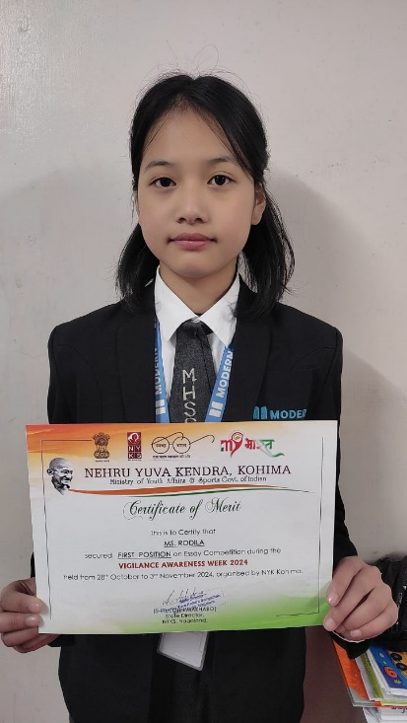
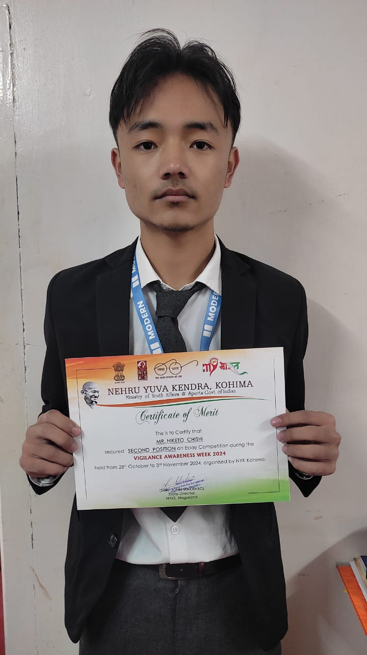
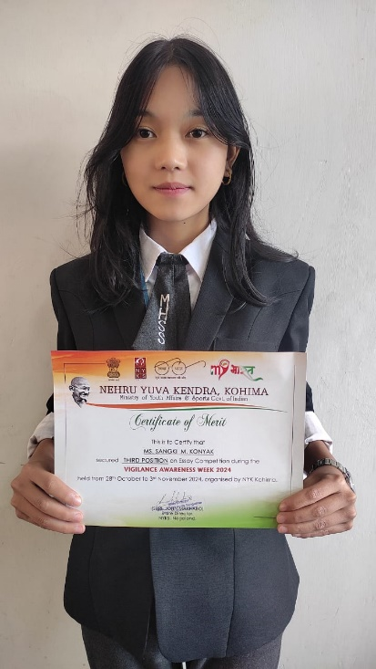
ACTIVITIES
Essay Competition
In commemoration of Vigilance Awareness Week essay competition was organised on the topic "Culture of Integrity for Nation's Prosperity" for Higher Secondary Students on 6th November, 2024.
The winners were
1st - Ms Rodila s Sangtam, 12 Science
2nd - Mr Hiketo Chishi, 12 Commerce
3rd - Ms Nyashom Sangki M Konyak, 11 Arts A
The winners received certificate and cash amount of ₹1500, ₹1000 and ₹500 each.
The prize money was sponsored by Nehru Yuva Kendra, Kohima.
1st
2nd
3rd

Slide 6
ACTIVITY
Seminar
On 7th November, 2024 Modern higher secondary organised a seminar on NEET and JEE Preparation for class 11 and 12 Science.
The main objective of the seminar was to help students to utilise their time smartly, strategy and preparation plan, mistakes to avoid and exam taking skills.
Dr. Rajesh Babu Pammi, Assistant Professor Modern Institute of Teacher Education was the resource person.
Dr. Rajesh highlighted the importance of setting goals and working everyday to achieve the goals and ambitions.

Slide 8
ACTIVITIES
Annual Picnic
Modern Higher Secondary School organised Annual Picnic for Middle and Secondary Section (Class 7 to 10) on 9th November, 2024 at Dzüü Resort, Rusoma, Kohima,

Slide 9
ACTIVITIES
Story Telling and Poem Recitation
To foster creativity, thinking, imagination and communication skills, the school organised a story telling and poem recitation competition for the students of classes 7-10 on 8th November, 2024.
It was held at the school S-1 from 12:00 p.m onwards.
The poem recitation competition was conducted for classes 7 and 8 with 8 participants and story telling competition for classes 9 and 10 with 7 participants.
Following were the winners in both the competition.
Poem recitation
1st- Asula
2nd- Engwang Yong
3rd- Sweety Das
Story Telling
1st- Keneilhounuo Zümvu
2nd- Sameer Sunar
3rd- Zoramthanga Renthlei
The winners were awarded with gifts and certificates.

Slide 11
ACTIVITIES
Annual Cultural Day
Modern Higher Secondary School celebrated its Annual Cultural Day on 9th November, 2024 in the school Auditorium with Mr. K.L Pamei as the Special Guest. The event was marked by vibrant display of tradition, colors, music and heritage.
Students and Faculties dressed in traditional attire celebrated the diversity of cultures represented at school, embodying the spirit of unity in diversity. The event aimed to foster cultural understanding, highlighting the richness of traditions within the school communities.
The day was marked by a variety of activities and competitions; Folk Songs, Cultural Dance, War Cries, cooking (Naga Cuisine), Art and Photography. Special Guest of the event Mr. K.L Pamei enthralled the students with his melodious soulful tune. Principal Ms. A. Nenia Theresa, in her keynote Address, emphasized the importance of cultural identity and preservation, welcoming the gathering with a heartfelt message on the significance of tradition. The Comperes of the programme were Mr. Victor K. Lohe and Ms. Atheli K. Achumi. Earlier in the programme Ms. Thejangunuo pronounced the Invocation Prayer and Benediction by Ms. Medozenuo Rupreo, Vote of Thanks was delivered by Mrs. Abenla Longkumer HOD, Department of Arts.
The programme concluded with distribution of citations and cash award for winners.

Slide 12
ACTIVITIES
Prodigy Hunt Examination
Modern Higher Secondary school in collaboration with Prodigy Brains conducted Prodigy Hunt Examination for classes 5-10 on 11th November, 2024.

Slide 13
ACTIVITIES
National Education Day
Every year, 11th November is observed as National Education Day to commemorate the birth anniversary of Maulana Abul Kalam Azad,the first education Minister of India, freedom fighter, Scholar and a very well known Academician.
The Department of Arts, Modern Higher Secondary School organised a talk by Ms Deepali Thapa to mark the occasion.
Ms.Deepali Thapa in her talk shared the importance of education in shaping India's future, how quality education is important for the societal progress and if we want to see india as a developed nation the one and only tool to achieve this goal is quality and inclusive education.
The program was chaired by Mr Puniang , Ms Nandita Rana invoked God's blessings and Ms. Meshenya Kath presented a special song. Vote of thanks was delivered by Ms Ilika Kiba and benediction was pronounced by Ms Imkonglemla N Longchar

Slide 14
ACTIVITIES
Pre-Christmas Clebration
On 13th Nov 2024, Foundational Section celebrated Pre-Christmas.
The programme began with an invocation pronounced by Ms.Toli Awomi, Ms. Nipusinuo conveyed about significance of Christmas and why it is celebrated?. Followed by, the students danced to the melodious tunes of 'Jingle Bells', 'Little Drummer Boy', 'Last Christmas' and 'We wish you a merry Christmas'. Further, it proceeds with a Christmas message by Mr. Indra Khabas, Headmaster, MHSS.Then, the Foundational teachers presented a Christmas Carol, 'oh come,all ye faithful'. Further, to continue the excitement and fun of the program, proceeded to cut the Christmas cake as a mark of Christmas celebration.
Later, the programme ended with vote of gratitude delivered by Ms. Moijem Konyak.

Slide 15
ACTIVITIES
Annual School Picnic
On 14th November, 2024 Annual School Picnic for Higher Secondary students was organized which was a resounding success, bringing together students and teachers for a day filled with fun and laughter.
The picnic not only fostered the friendship but also reinforced the importance of collaboration between teachers and students. The students enjoyed playing games, food and beautiful places to the fullest.

Slide 16
ACTIVITIES
Children’s Day
“Children are like buds in a garden and should be carefully and lovingly nurtured, as they are the future of our nation and the citizens of tomorrow.”
Pt. Jawaharlal Nehru
Children’s Day was celebrated with vigour and enthusiasm by the children and teachers of Modern Higher Secondary School, Kohima on the 14th of November, 2024 at the school auditorium.
The day began with invoking of God's blessing upon the congregation and for the success of the event by Mr. Hmingthan Mowia, Office Manager MHSS. Welcome song was presented by the students of the Foundational section, who took us back in time with their adorable performance.
Exhortation was shared by Mr. Indra Bahadur Khabas, Headmaster MHSS, who urged the students to bring about positive change in their lives and in the society, and for which he emphasized the importance of educations as the key to unlocking these potentials. Furthermore, he encouraged the students to never stop learning and to keep believing in themselves.
As the day progressed, the most awaited session, i.e the entertainment session soon unfolded whereby the students were taken aback and exhilarated by the fun filled performances by the teachers.
In recognition of their efforts and dedication towards achieving 100% attendance, the students were awarded with certificates of appreciation by Mrs. A. Kaisa Hekha, Chairperson Modern Society of Education. Whereas, Ms. Gitanjali Chanu of class 10 and Mr. Shuhruo Francis of class 5 were each awarded with cash prize for best cultural attire.

Slide 17
ACTIVITIES
The vote of thanks was proposed by Mr. Rokovituo Rino, as he acknowledged the sincere efforts and contributions of everyone involved for the successful completion of the event and benediction was pronounced by Ms. Toli Awomi.

Slide 18
ACTIVITIES
Golden Jubilee Celebration of NBSE
On 16th November, 2024, Modern Higher Secondary School took part in the Golden Jubilee Celebration of NBSE at Capital Cultural Hall, Kohima.

Slide 19
ACTIVITIES
3rd Annual Sports Meet
Modern Higher Secondary School successfully held its 3rd Annual Sports meet from November 21st to 23rd November 2024 under the theme ‘Higher, Faster, Stronger', promoting both physical well-being and holistic learning among students.
The Inaugural Programme was held at Modern college, Piphema on 21st November with Mr. Pelee Hekha, Managing Director as the Chief Guest, wherein he ignited the spirit of sports as one of the healthiest competition and encourages the students to make it a memorable event.
The event kicked off with an inspiring address by Special Guest Mr. Pelee Hekha who also declared the Sports meet open while Ms. A Nenia Theresa Principal MHSS gave the Welcome Address.
The three day event featured a variety of sports activities both indoor and outdoor activities. Carrom, Chess, badminton, TT, Volleyball, Basketball, Football, 100m, 200m, Rally Race, Tug-of-war and Arm Wrestling.
The Event concluded on 23rd November, where medals and Certificates were awarded to the participants. Yellow House emerged as the overall champion of the event, while Red House and Green secured the first and second runner-up positions respectively.
The three-day event witnessed exciting games and closely contested matches amidst cheers and applause as the students demonstrated sportsmanship and encouraged their teammates and competitors alike.

Slide 21
ACTIVITIES

Slide 22
ACTIVITIES
Samvidhan Divas
Modern Hr.Secondary School celebrated Samvidhan Divas also known as Constitution day on Tuesday 26th November, 2024.
The main objective of the program was to inculcate constitutional obligations among the students, to create awareness about constitution and to sensitize the students about the importance of constitution day.
Speech was delivered by Ms Lochumi Patton, Department of Arts she highlighted the significance of the day and history of constitution day celebration which was followed by a pledge to uphold the ideals of justice, equality and liberty enshrined in the constitution of India.

Slide 23
ACTIVITIES
Graduation Day
Foundational Section held its Graduation Day for Class-2 on 28th November, 2024 to applaud young learners of Class-2.
The program was hosted by Ms. Moijem Konyak.
The program was commenced with the Processional of the Graduates. This was followed by, the graceful dancers of Class-1 gave a mesmerizing performance. After this, Anik Debnath of Class-2, on behalf of Class-2 expressed his gratitude towards his Teachers for their efforts and concern. Then, another enthralling 'It's a beautiful day' was performed by KG which lit up the stage. Later, Mrs. A. Kaisa Hekha, Chairperson facilitated the students with graduation certificate. Eventually, the Graduates of Class-2 performed a sweet-sounding song 'Season in the sun'.
The program concluded successfully with vote of thanks delivered by Ms. Kazhuni,Coordinator, Foundational.

Slide 24
ACTIVITIES

Slide 25
ACTIVITIES
Farewell Programme
A farewell programme was organized for the outgoing Cass 12 batch in the auditorium on 29th November, 2024 under the theme "Nostelgia Avenue".
The comperes of the programme were Ms.Kumsukali and Mr. Toshiemba Jamir. The programme begun by invoking God's blessing by Ms. Thejangunuo Bio. A warm Welcome speech was delivered by Mr. Nganhanthem Seipainao on behalf of the juniors. Ms. A. Nenia Theresa, Principal MHSS addressed the students with the valedictory speech, encouraging the students to strive for the best. Mr. Lemrimong and Mr. Mhonjan Kithan of Class 11 and 12 delivered speech respectively. The programme also featured some entertainment by
Students of both Class 11 and 12 enthralling the crowd with songs and dances.
The programme concluded with a vote of thanks by Ms. Anita Thapa and Ms. Achungla Anar pronounced the benediction, followed by photo session.

Slide 26
ACTIVITIES

Slide 27
ACTIVITIES
Faculty Development Program
Modern Higher Secondary School in collaboration with Modern Institute of Teacher Education organised an Orientation on “Demonstration School” and Faculty Development Program on "Different Methods in Teaching “ on the 29th of November, 2024 at the Conference Hall.
The compere of the program was Mr. Athishu Andrew, coordinator Preparatory Section. The program begin with an invocation prayer by Ms. Imkongsangla, Middle and Secondary Teacher followed by orientation on Institutional Distinctiveness on "Demonstration School" by Ms. Kavani Hekha, IQAC Coordinator MITE.
Ms. Hekha spoke on its purpose and the importance of Collaboration between the High School and Modern Institute of Teacher Education .
The Resource Persons for the FDP were:
Dr.Kate Dandesh Kumar;
Principal,MITE
Pedagogy of Teaching Science.
Dr. Rajesh Babu Pammi;
Asst.Professor
Pedagogy of Teaching Mathematics
Ms. Limanenla Lkr;
Asst. Professor
Pedagogy of Teaching English
Ms. Holivi Y Kiba;
Asst. Professor
Pedagogy of Teaching Social Sciences.

Slide 28
ACTIVITIES
The resource persons addressed on different Methods, Techniques, Strategies and Skills to be applied in teaching different subjects from the Foundational to the Secondary level.
The program concluded with vote of thanks by
Ms. Neha Gurung, Preparatory Teacher and benediction was pronounced by Ms. Sanano Chanu, Preparatory Teacher.

Slide 29
ACTIVITIES
Faculty Development Program
Faculty Development Program for Foundational Teachers was organised on 2nd to 6th December, 2024.
Day-01
The Resource person for the Faculty Development Program was Ms Toli Awomi. She briefed about the importance of Vowels and Consonants of Hindi, and further illustrated on how to read and write. The teachers were engaged with various activities hence bringing the teaching aids into play.
Day - 02
The FDP commenced with Ms. Shelih as the spokesperson on the topic '5E Models'. She elucidated on how to create an effective and engaging classrooms by following the 5E
Day-03
Faculty Development Programme was conducted on the topic 'Montessori Method of Teaching' by Ms. Neipusinuo Suohumavu, She elucidated on the benefits of Sensorial Activities on how Geometric Solid Box helps to improve the child's sterrognostic sense
Day-04
Resource person for the FDP was Ms. Kateni Rose wherein she spoke on the 'Pattern of writing' and illustrating on the importance of letter formation, word spacing and line spacing.
Day-05
The FDP was ushered by Ms. Kazhüni Mahreo, the Co-ordinator of the Foundational Section. She elaborated on the needs, and use of Audio Visual Aids which helps create the environment of interest for the students.

Slide 30
ACTIVITIES

Slide 31
ACTIVITIES
Pre-Christmas
Modern Higher Secondary School Staff organised Pre-Christmas on 7th December, 2024 in Hotel Japfü.

Slide 32
What Christmas Means To Me
If you ask me What Christmas means to me? I would probably say that it is a time where I can reflect on the things I have done whether it be good or bad. But it also helps me to show and express my gratitude for all the blessings I have received throughout the year. It helps me end the year with optimism and hope. I always believe that as I enter the new year, I would grow mentally and spiritually and change my perspective on life in a positive way.
-Hamingthan Mawia
Teacher
"Being a light in the era of darkness" Christmas to me is all about Jesus and a time of giving. It's not only about family gatherings, decorations or merry making but it's about having a heart of Jesus and sharing love through giving. It's about being a channel of God's blessing and a ray of light among the people around us.
-Imkongsangla
Teacher
Christmas is a time of love, joy, and communion. A time to be grateful for everything that I have been blessed with; knowing that I am highly loved and favored by God because of His Son Jesus. It's also a season to cherish memories with family and friends, and to create new ones. For me, Christmas is about the warmth and magic of the spirit of kindness and generosity. It's a time to reflect on the true meaning of Christmas and to celebrate the gift of love, hope, and redemption.
-Sanano Chanu
Teacher

Slide 33
What Christmas Means To Me
Christmas for me, when I was a child and though I knew what it was ‘about the birth of Jesus Christ’, there was more interest in the Christmas dress that our family would buy, about the Christmas Carol me and my friends use to go, singing the classic Boney M songs, so that we can gather some money to celebrate Christmas eve. It was also about neighbours and family coming together to share a simple meal together. Putting up the Christmas star which was for many years, the sole Christmas decoration, coming from a middle class family. And occasionally, we were able to afford one or two cakes which we would gift it as Christmas cake.
And as I grew, both in years and wisdom, I learnt that Christmas is a time to reflect on the foundation of our faith and celebrate God’s love for us. It is a time to give thanks to God for the love, hope and joy that we received through Jesus Christ. I learnt that Christmas is a time of thanks giving, just as God gifted us His Son Jesus Christ.
-Kikatemba Ozukum
Dept. of Science
Christmas for me is a time of joy, celebration and spending time with loved ones. It is a time of giving and showing gratitude to people in our lives. But most importantly Christmas is a day to remember the birth of Jesus who came into this world to pay for our sins, so that we may all have everlasting life. "For God so loved the world that he gave his only begotten son, that whosoever believes in Him shall not perish but have everlasting life" John 3:16
-Neipusinuo Suohomvü
Teacher

Slide 34
POETRY
Why I Write!
I write!
When my heart gets too heavy to hold,
When the world is being cruel.
I write about my scars ,
Old and New.
I write, when I have a lot to share!
But to hear me,
No one has time to spare.
I write, to share my thoughts,
And not with the desire to be known.
I write to free my self,
Deep down within my Soul.
-Victor K Lohe
Class- 11 Arts B

Slide 35
QUOTE
Why are we becoming dirty? When we try to wash off the dirt! Why are we washing something? which cannot be washed!
It is harmful when we don't wash, but when we wash it we become harmful.
-Johnson Chetri
Class-12 Commerce

Slide 36
MESSAGE
Appreciation of Little Things
As I walked along the beach, feeling the warm sand beneath my feet and the gentle breeze on my skin, I realized that life's beauty lies in its simplicity. After facing a challenging year, I learned to appreciate the little things a sunrise, a supportive friend, or a good cup of coffee. These moments remind me to stay present and grateful. Life may not always be easy, but with resilience and positivity, we can turn every obstacle into an opportunity. Embrace each day with hope and kindness, and know that every sunrise brings a chance to start anew.
-Lemrimong
Class- 11 Arts A

Slide 37
CAMPUS DIARY
Highlight of the Month (Higher Secondary Section)
November & December
1st November : Assembly (I/C Dept. of Arts)
2nd November : Declaration of Mid Term Examination Result
(Parents Teacher Meeting) & Pre Board Examination Result
4th -29th November : Special Class
7th November : Administration Meeting
9th November : Cultural Day
11th November : Observation of National Education Day (I/C Department of Arts)/ Monthly News Letter
14th November : Class Picnic (11 Arts/ 12 Arts/ Dept. Of Commerce/ Dept. Of Science)
18th November : Departmental Meeting
20th -22nd November : Sports Week (Tentative)
27th November : HoD’s Meeting/ Observation of Constitution Day (Department of Arts)
30th November : Farewell to Class 12
2nd -4th Dec : Special Class/ Conduct of HSSLC Practical Exam 2025 (Physic, Chemestry & Biology)
4th Dec : Conduct of HSSLC Practical Exam 2025 (Accountancy & Enterpreneurship)
5th -12th Dec : Pre Board Exam for class 11 & Improvement Exam for class 12
7th Dec : Departmental Meeting ( Students Engagement Planning)
10th Dec : HOD’s Meeting
13th Dec : Monthly News Letter
14th Dec : Result Declaration of Pre-Board (Class 11) & Improvement (Class 12) Exam
16th -31st Dec : Winter Vacation
To look Ahead
January 2025
1st – 6th Jan : Winter Vacation
7th Jan :Reporting for Teachers & Non Teaching Staff/ Staff Meeting
8th -21st Jan : Preparatory Classes
16th Jan : Issue of Admit card for Model Test
21st Jan : Assembly (I/C Teachers)
22nd -31st Jan : Model Test

Slide 38
CAMPUS DIARY
Highlight of the Month (High School Section)
November & December
1st November : Issue of Admit card for Final Exam
2nd November : Submission of IPR/ Class Picnic (Cl 7 to 10)
4th -7th November : Exam for Minor Subjects
12th November : Pre- Christmas (Foundational)
14th November : Children’s Day cum Cultural Day
18th -27th Nov : Final Exam (Cl 3to 7)
28th November : Issue Of admit card for Final Exam Phase-II
(Cl 8&9)/ Model Exam (Cl-10)
29th November : End of Remedial Class (Cl-8&9)/ Graduation Day/ Result of Final Exam (Foundation)
3rd Dec : Submission of IPR
2nd -7th Dec (Tentative) : Final Exam Phase-II (Cl-8 &9)/ Model Exam (Cl-10)
6th Dec : Declaration of Final Exam Result (Cl-3 to 7)
9th -13th Dec : Special Class for Class 10
13th Dec : Declaration of Final Exam Result (Cl 8&9) / Model Exam Class 10/ Student Engagement schedule to be s hared- Headmaster
18th Dec : Winter Vacation
To look Ahead
January 2025
10th Jan : Teachers Reporting day/ Staff meeting (Tentative)
13th Jan : Start of special class (Cl-10 Outgoing)
16th Jan :Re-opening for Class 9 & 10 (Present)
17th Jan : issue of Admit Card for Model Exam
20th -28th Jan : Improvement Exam (Cl-10 Outgoing)
Compiled by:
Khrotso Koza, Imsunungla Jamir & Abenla Longkumer

